Slide 1
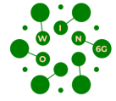
Optical Wireless Communication – Trade-off between different parameters – Part I
Prof Zabih Ghassemlooy, Northumbria University, UK
Prof Stanislav Zvanovec, Czech Technical University in Prague, Czech Republic
Dr Luis Nero Alves, Uinsti. De Telec., University of Aveiro, Portugal
Dr Ali Khalighi, Ecole Centrale Marseille, Institut Fresnel, France
Dr Mónica J C de Figueiredo, Politécnico de Leiria, Portugal
Dr Anna Maria Vegni, Università degli Studi Roma Tre, Italy
Dr Joaquin Perez Soler, Universitat de València, Spain
Dr Xicong Li, Northumbria University, UK
Prof Hoa Le-Minh, Northumbria University, UK
Dec. 2024
z.ghassemlooy@northumbria.ac.uk

Slide 2
Introduction
A system is a complex entity to deal with it, where there are so many parameters needs to be considered to achieve the required performance metrics. This process also involves trade-off between many different parameters and performance metrics. This set of slides outlines some of the key modules and their features in optical wireless communication systems, as well as the key performance indicators. It is by no means a complete overview but is a starter that could be beneficial to MSc and PhD students doing research in optical wireless communications, which can also be applied to other communications with some changes.
Any comments, suggestions, etc. are welcome.
Z. Ghassemlooy

Slide 3
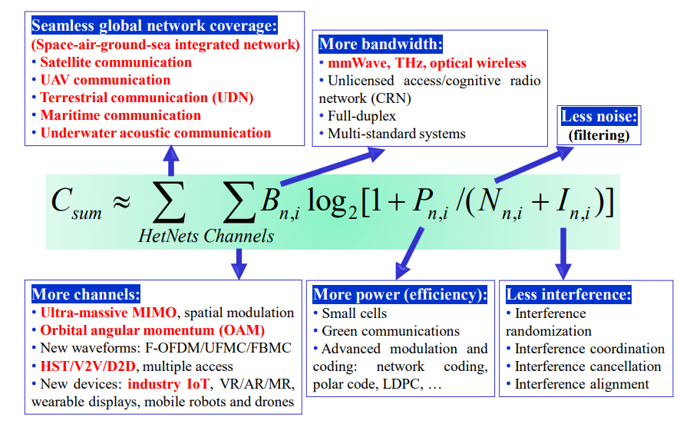
Communication System
x(t)
r(t)
d(t)
Transmitter (Tx)
Channel
Receiver (Rx)
$$\hat{d(t)}$$
n(t)
$$r\left(t\right)=x\left(t\right)h\left(t\right)+n\left(t\right)+i(t)$$
Noise
+
Interference
C_{sum}:
B
P
No. of channels (space/time/frequenc)
No. of HetNets
Channel capacity
Interference
Noise
C. -X. Wang, J. Huang, H. Wang, X. Gao, X. You and Y. Hao, "6G Wireless Channel Measurements and Models: Trends and Challenges," in IEEE Vehicular Technology Magazine, vol. 15, no. 4, pp. 22-32, Dec. 2020, doi: 10.1109/MVT.2020.3018436.

Slide 4
Performance Metrics
Spectral efficiency
&
Energy efficiency
Bandwidth
&
throughput
RSSI
SNR/SNIR
PNR
ENR
Linearity
&
dynamic range
KPIs
Latency
&
Jitter
Power & rise time (bandwidth) budgets
Complexity
&
costs
Data rates
Interference
Metrics - Ways to measure the performance of communication systems and provide a clear picture of network performance.
How to use metrics?
Measure the actual performance of real systems
Calculate/estimate to predict performance of planned systems
Represented using different statistics
Instantaneous
Average (mean) over some time
Maximum (peak)
Minimum,
Standard deviation
Variance, . . .
BER
SER
PER
Outage Prob.
Standards
Eye & constellation diagrams
&
EVM
Coverage
& mobility
Connectivity
density
Z. Ghassemlooy

Slide 5
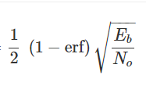
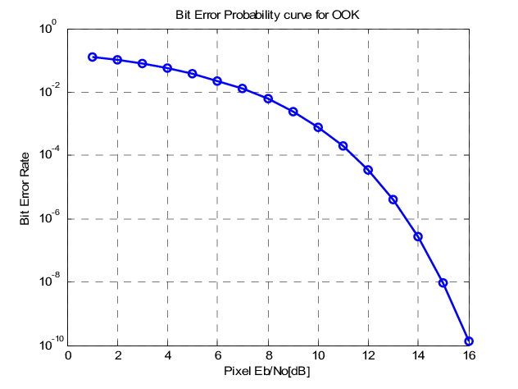
BER
Is a function of the type of:
Modulation
Characteristics of the modulator and demodulator
Quality of the transmission channel.
May be affected by:
Order of modulations
Lower order modulation but at the cost of data throughput.
Transmit power P_{t}
Transmission channel
attenuation
multipath fading
noise
Bandwidth B
Interference I
Distortion
Bit synchronization problems
etc.
E.g., OOK-NRZ
$$BER=\frac{1}{2}erfc\left(\frac{1}{2\sqrt{2}}\sqrt{SNR}\right)$$
$BER =Q(\sqrt{SNR}$)
BER =
$BER =Q(\sqrt{\frac{E_{b}}{N_{0}}}$)
$$E_{b}=E_{m}/K$$
Message energy
K: Information bits → to the encoder/modulator
The challenge is to achieve low BERs at low E_{b}/N_{o} or S/N levels.
Z. Ghassemlooy

Slide 6
Physical Layer
Tx
Channel
Rx
KPI
Data
Coding
Mod
Mux
Amp
LED/LD
Tx mode
Equ.
Lense
&
Beamforming
Noise
Interference
Type (single & multilevel)
Bandwidth - optimized to use available frequency spectrum
Mod. Index
Encryption and error correction
Adaptable
Power (avg, max)
P_{min} to deliver SNR
Synch.
Format
Pulse shaping
Bandwidth
Power (avg, max)
Synch
Single or multiple
Types and beam profiles
Cells size and density
Field of view
Wavelength
Maximum current I_{max}
Voltage V_{min} & V_{max}
Power out (illumination) P_{o}
P_{o} vs. I plot
Dynamic range
Non-linearity
Bandwidth B_{LED}
DC-biasing
Diversity
LOS
NLOS
Diffused
Loss
Dispersion
Type
Bandwidth
Power usage
Type
Size
Power loss
Beam size and minimum P_{t}
Complexity
Types
Efficiency
BER, ENR and SNR
Complexity
Types
Efficiency
Gain
Linearity
Z. Ghassemlooy

Slide 7
Physical Layer
Tx
Channel
Noise
Interference
KPI
Rx
Indoor/outdoor
Length
LOS
NLOS
Transfer function
Bandwidth (capacity
Losses
Fading
Dispersion
Static/dynamic
Shadowing/blocking
Conditions: Fog, rain, turbulence, etc.
Others
Types and sources
Shot noise
Signal depen,
Ambient light
Dark current noise
Thermal noise
Amplifier noise
Noise in IS-based Rx
PSD
Standard deviation
Dominant noise
Type
Sources
Lense
PD/APD/IS/PV
Type and size
Field of view
Responsivity (minimum power)
Power vs. current charac.
Bandwidth
Amplifier
Type
Gain and linearity
Bandwidth
Decoding/Demultiplexing/Demodulation
Detection schemes
Hard/soft (slicing, MF, etc.)
Processing time
Diversity
Equalizer
Synchronization
Power usage
Z. Ghassemlooy

Slide 8
Some Examples
Transmitter power P_{t}
P_{t} → SNR → BER
But,
→ Interference to other users → SNIR → BER
→ Size of the power amplifier + nonlinearity
→ Overall power consumption
→ Battery life
Overall cost
Bandwidth B
As B → noise → SNR
But → data throughput + S → SNR → BER
Z. Ghassemlooy

Slide 9
Some Examples
Interference I
Generally, this is set by external factors and cannot be changed by the system design.
More problematic in frequency/wavelength multiplexing-based systems
Due to:
Competing wireless devices
Time/frequency/wavelength reuse
Can be reduced by:
Guard bands between channels → Bandwidth for data → Data throughput
Better filtering → Complexity
Lower system bandwidth → data rate
Lower Pt → SNR → BER
Multiuser detection and spread spectrum → Complexity
Directional antennas → Complexity
Dynamic channel allocation → Complexity
Can lead to several issues::
Reduced signal power → SNR → BER
Dropped connections → Delayed downloads
Network slowdown - Reduced coverage and capacity
Z. Ghassemlooy

Slide 10
Some Examples
How to achieve the required BER performance
E.g., a BER of 10⁻⁶, for high-quality data communications
BER: 10⁻⁶
Not what we wanted
Not what we wanted
SNR or ENR
SNR or ENR
Not the best option
S or E
N
Complexity
Mod. Type
I
ℜ_{Rx}
B/W
Filtering
If too low
→ S or E
If too narrow
→ S or E
Non-lin.
η_{Eng}
Costly
devices
Har. Dis.
BER
BER
Z. Ghassemlooy

Slide 11
Coding/Decoding
Some Examples
Efficient use of bandwidth
Tolerance to noise → Improved ENR and SNR → BER
BER vs coding type
Complexity and cost
Standards
Trade-off between error detection and correction capabilities – Depends on the specific application.
In applications where:
Error detection – High code rates such as convolutional codes.
Error correcting – Lower code rates such as:
Turbo codes
Low-density parity-check codes
Concatenated codes.
Z. Ghassemlooy

Slide 12
Identify Problems
Problems might be originated from either devices or from modules.
Some common issues are:
Hardware incompatibility
Impedance mismatch
Configuration error
Lack of bandwidth
Saturation or cut-off
Phase delay
Operating outside a dynamic range
etc
Monitor Systems
Investigate Root Causes
Fix Problem
Z. Ghassemlooy

Slide 13
Thank you!
Z. Ghassemlooy

